Slide 1
Tissue Identification Extra Credit There will be a quiz over the tissues displayed in this PPT. You will be asked to identify the tissue type based on the photographs provided in this presentation. Each correctly identified tissue will correlate to one bonus on the next exam (chapter 4). Do Not try to memorize the order; take time And try to truly understand the structure of the tissues.

Slide 2
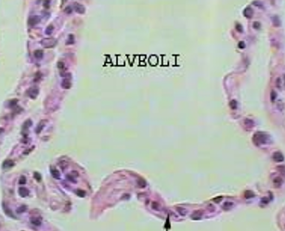
Simple Squamous Epithelial

Slide 3
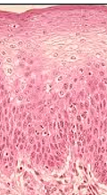
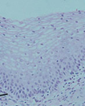
Stratified Squamous Epithelial

Slide 4
Simple Cuboidal Epithelial

Slide 5
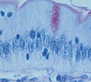
Simple Columnar Epithelial

Slide 6
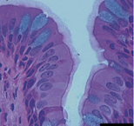
Pseudostratified Columnar Epithelial

Slide 7
Transitional Epithelium

Slide 8
Loose, or areolar Connective

Slide 9
Adipose

Slide 10
Dense Collagenous Connective

Slide 11
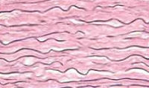
Dense Elastic Connective

Slide 12
Hyaline Cartilage

Slide 13
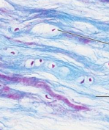
Fibrocartilage

Slide 14
Elastic Cartilage

Slide 15
Bone

Slide 16
Blood

Slide 17
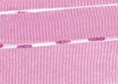
Skeletal Muscle

Slide 18
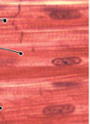
Cardiac Muscle

Slide 19
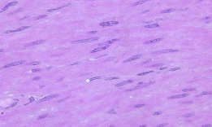
Smooth Muscle

Slide 20
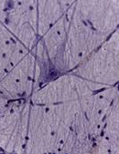
Nervous Tissue

